Slide 1

INTERNSHIP PROGRAM
Names:
Omar Muhammed
Doaa Salah
Menna Mostafa

Slide 2
Main Project
Generative Video Indexing

Slide 3
Workflow

Slide 4
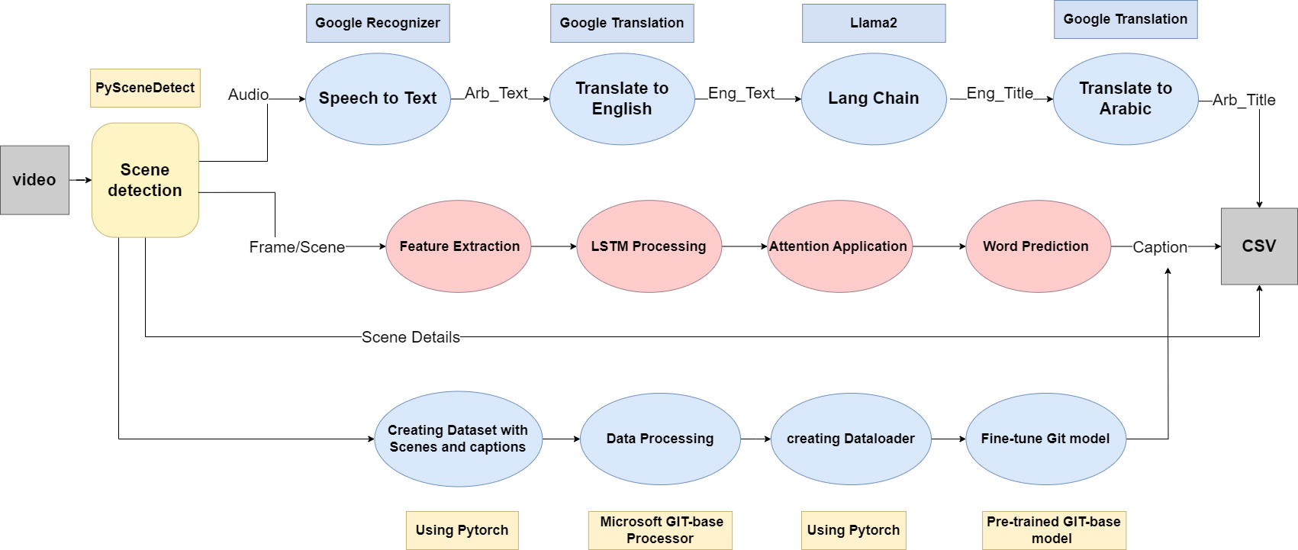
Workflow

Slide 5
Tools
Python
Scene Detect
Google Speech Recognition
Google Translation
Hugging Face
Lang chain
LLama2
Tensorflow
Img_cap model(CNN+RNN)
Attention Mechanisms

Slide 6
Methodology

Slide 7
Methodology
Scenes detection:
Split Video to Scenes (Adaptive content)
Change in HSV color
Comparing neighboring frames
Save a frame per scene
Save a CSV for Scenes Details
2. NLP Approach
3. Vision Approach

Slide 8
NLP Approach
2.1 Speech to Text
Convert Video to wav
Detect length of scene:
Small Scene (<5 sec)
Middle scene (between 5 and 200 sec)
Large scene (> 200 sec)
Google Recognizer
Allow Dynamic Energy Threshold
Adjust Ambient Noise

Slide 9
NLP Approach
2.2 Translate from Arabic to English
Google Translate
2.3 Create Title chain
Loading Llama2
Create Prompt Template
2.4 Translate from English to Arabic
Google Translate

Slide 10
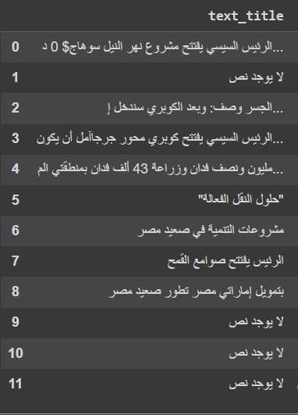
NLP Approach
2.5 Create a CSV For Arabic Title

Slide 11
The image captioning challenge
-> generating natural language description is difficult
–-- producing human-like sentences
-> Requires capabilities beyond image classification
–-- language model must capture semantics , grammar , sentence structure
-> Dataset have limited captions example per image
-> modeling word sequences and long-term dependices
-> linking words and sentences to visual evidence
-> Lack of end-to-end pre-trained image captioning models
–-- Need to manually assemble and train components like CNN , RNN, attention mechanism

Slide 12
The model architecture and solutions
-> leverages pre-trained CNN like RESNET50 for visual recognition
-> LSTM effectively models word sequences < hidden state concept >
- hidden stack memory solves long sequence problem Hidden state gives a particular values to each word and increase that values of that word if it found it later in another sentence or the same sentence thus acting as a memory cell
<encoding> hidden state produces query vector results from assigned values the RNN in LSTM give to a sentence this query will then play a crucial part in the attention mechanism
-> Attention mechanism<decode>
-LSTM hidden state is the query
-Compared to ResNet features
-Highlights important areas
-Merges visual and text features
-Creates context vector for decoder

Slide 13
-> Training and Optimization
-CNN is pretrained on ImageNet or fixed after minimal training
-LSTM and other layers trained from scratch
-Standard cross entropy loss on word predictions
-Adam or RMSprop or SGD optimizers were used with option to switch

Slide 14
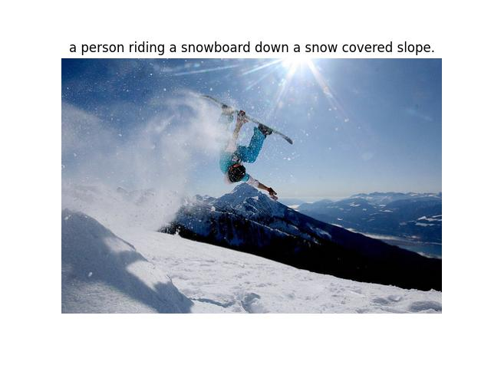
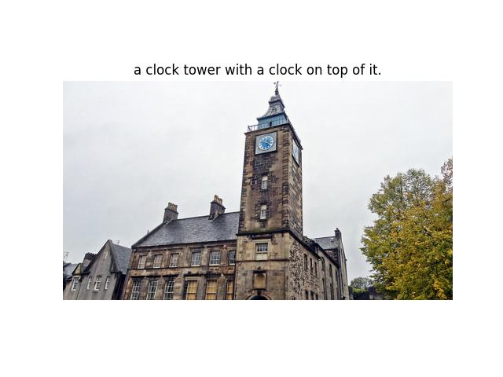
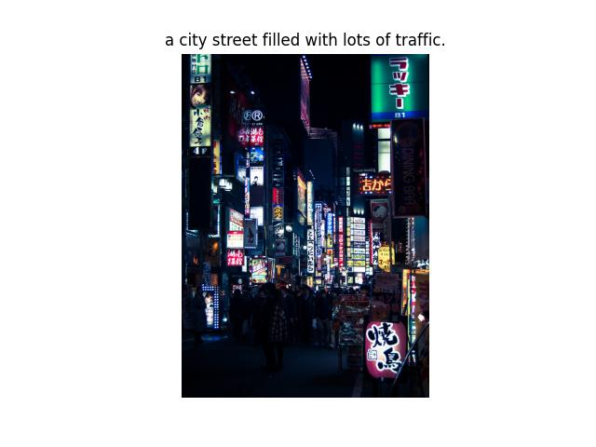
RESULTS OF THE MODEL BEING TRAINED ON COCO2017 DATASET

Slide 15

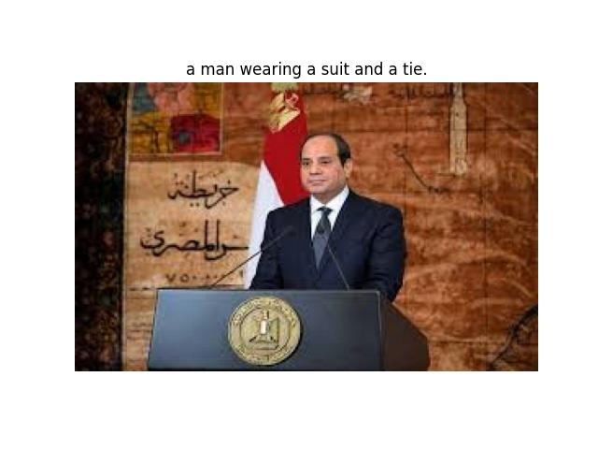
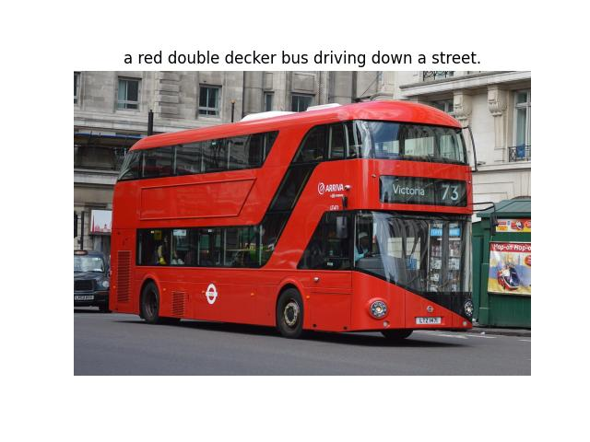

Slide 16
The Custom Dataset for Fine-tuning
Dataset Name: Video Indexing Dataset
Description: A custom dataset containingts Image C images related to projects initiated by El Sisi, the President of Egypt.
Details:
Number of Images: 100
Number of Captions: 500 (5 variant captions per image)
Image Content: Each image depicts a scene or aspect of El Sisi and his projects, such as infrastructure, public events, or developmental activities.
Annotation Specifics:
Each caption is structured to describe the image content in a descriptive manner with syntactical and semantic consistency.
Captions provide varied descriptions to enhance the model's ability to generalize from the dataset.

Slide 17
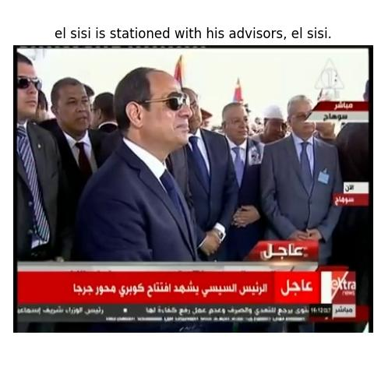
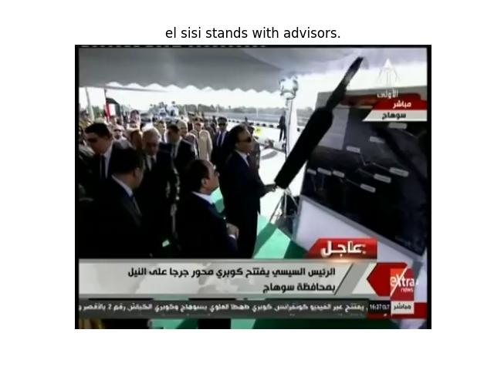
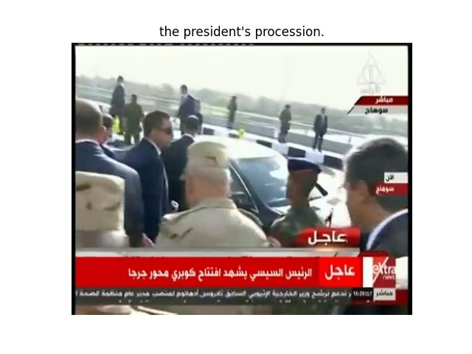
Results of the model being trained on the custom dataset

Slide 18
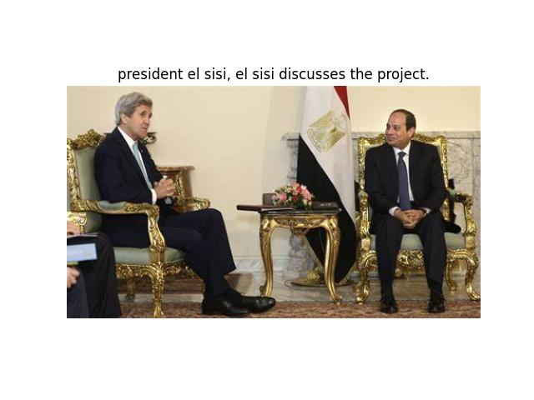
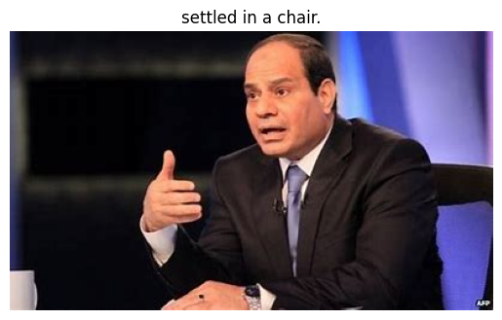

Slide 19
RESNET50&LSTM VS. TRANSFORMERS
The CNN + LSTM approach is more lightweight and has fewer parameters to train. This can help avoid overfitting on smaller datasets.
CNN image features provide a fixed set of visual representations to ground the captions in. The vision transformer features are dynamically generated and may not always focus on the most relevant regions.
LSTM models temporal information and history very well with its hidden state. The attention mechanisms in transformers may not capture sequential dependencies as effectively.
LSTM training is generally more stable and better understood. Transformer models can be unstable and difficult to optimize without careful parameter tuning.
The modular architecture allows flexible swapping of CNN and LSTM models. The end-to-end transformer requires retraining the full stack even for small changes.
Wide availability of pretrained CNNs like VGGNet or ResNet is a benefit. Pretrained vision transformers are less common and may require training from scratch.

Slide 20
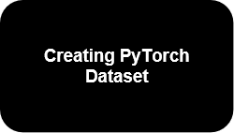
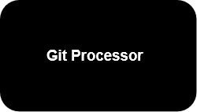
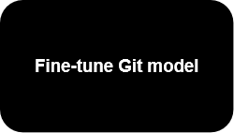
3.2 -Vision Approach
Pipeline :

Slide 21
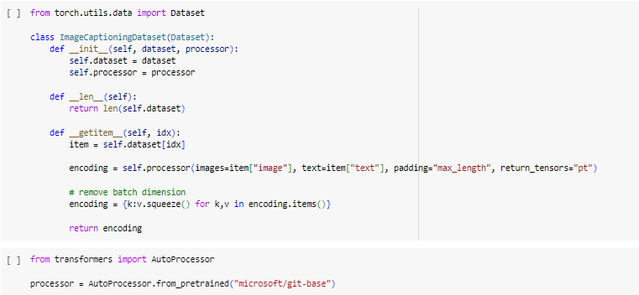

DataLoader
created the DataLoader to allow us to get batches of data from the dataset.
used GitProcessor to turn each (image, text) pair into the expected inputs.

Slide 22
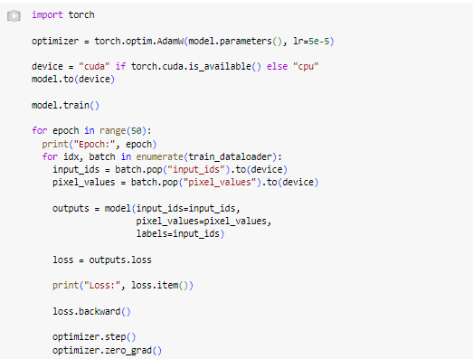


Architecture of the model

Slide 23
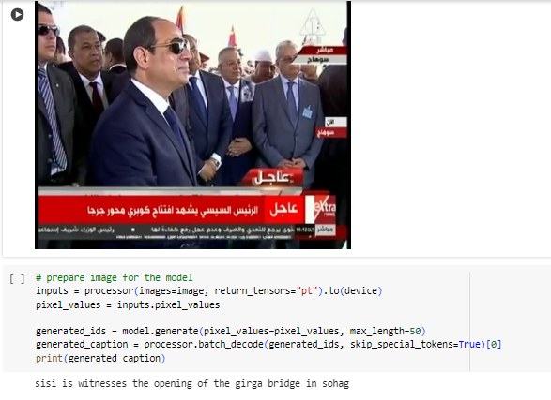
3.2 -Vision Approach
Results of the model :

Slide 24
Limitations
Ambient noise
Increasing Data of image caption model

Slide 25
Next Milestone
Replace the models with Updated ones
increase images Dataset
Handle ambient Noise
make the application automated

